Slide 1
Radix-2 DIT FFT Algorithm
SAMIRAN BASAK

Slide 2
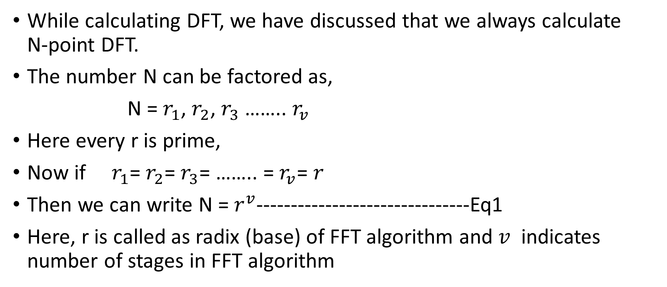
Basic Idea of Radix-2 Algorithm
While calculating DFT, we have discussed that we always calculate N-point DFT.
The number N can be factored as,
N = $r_{1}$, $r_{2}$, $r_{3}$ …….. $r_{v}$
Here every r is prime,
Now if $r_{1}$= $r_{2}$= $r_{3}$= …….. = $r_{v}$= $r$
Then we can write N = $r^{v}$-------------------------------Eq1
Here, r is called as radix (base) of FFT algorithm and $v$ indicates number of stages in FFT algorithm

Slide 3
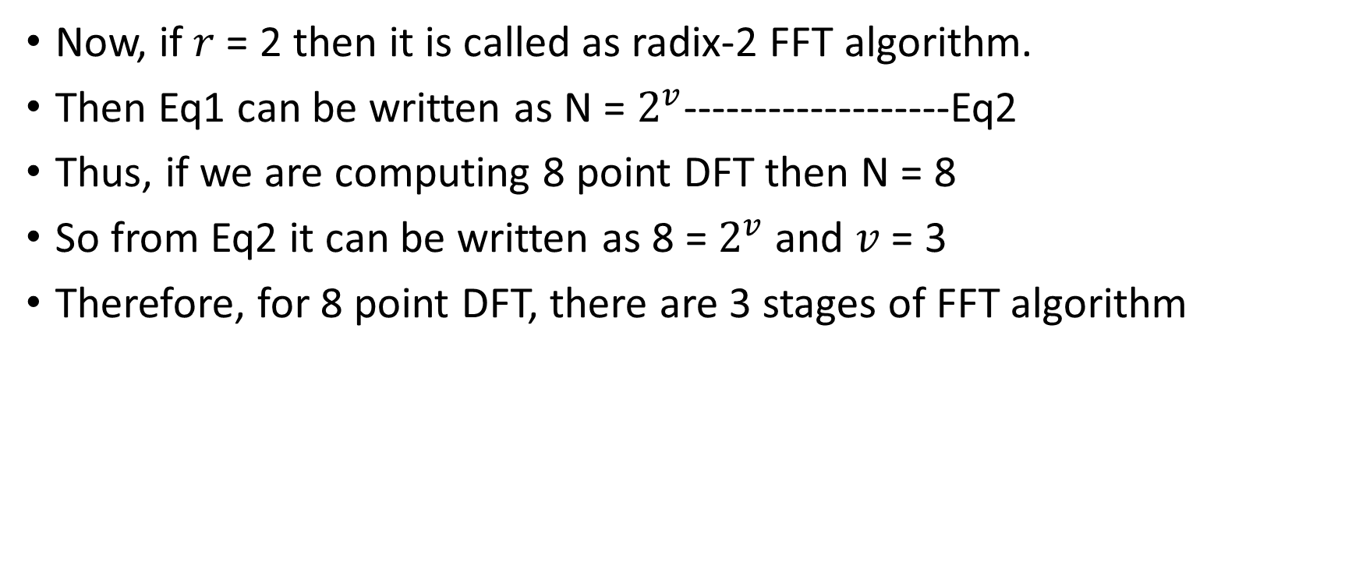
Basic Idea of Radix-2 Algorithm
Now, if $r$ = 2 then it is called as radix-2 FFT algorithm.
Then Eq1 can be written as N = $2^{v}$-------------------Eq2
Thus, if we are computing 8 point DFT then N = 8
So from Eq2 it can be written as 8 = $2^{v}$ and $v$ = 3
Therefore, for 8 point DFT, there are 3 stages of FFT algorithm

Slide 4

Some properties of Twidle Factor, used in FFT
$W_{N}^{k+N}$= $W_{N}^{k}$
$W_{N}^{k+\frac{N}{2}}$= ${− W}_{N}^{k}$
$W_{N}^{2k}$= $W_{\frac{N}{2}}^{k}$

Slide 5
Radix-2 Decimation In Time (DIT) FFT Algorithm
Word ‘Decimation’ means to break into parts.
DIT indicates dividing or splitting the sequence in time domain.

Slide 6
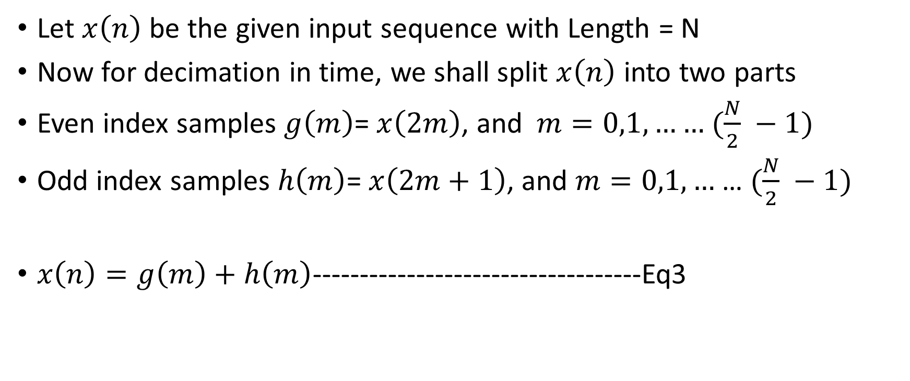
Radix-2 Decimation In Time (DIT) FFT Algorithm
Let $x\left(n\right)$ be the given input sequence with Length = N
Now for decimation in time, we shall split $x\left(n\right)$ into two parts
Even index samples $g\left(m\right)$=$x\left(2m\right)$, and $m=0,1,……$ $(\frac{N}{2} −1)$
Odd index samples $h\left(m\right)$=$x\left(2m+1\right)$, and $m=0,1,…$ … $(\frac{N}{2} −1)$
$x\left(n\right)=g\left(m\right)+h\left(m\right)$-----------------------------------Eq3

Slide 7
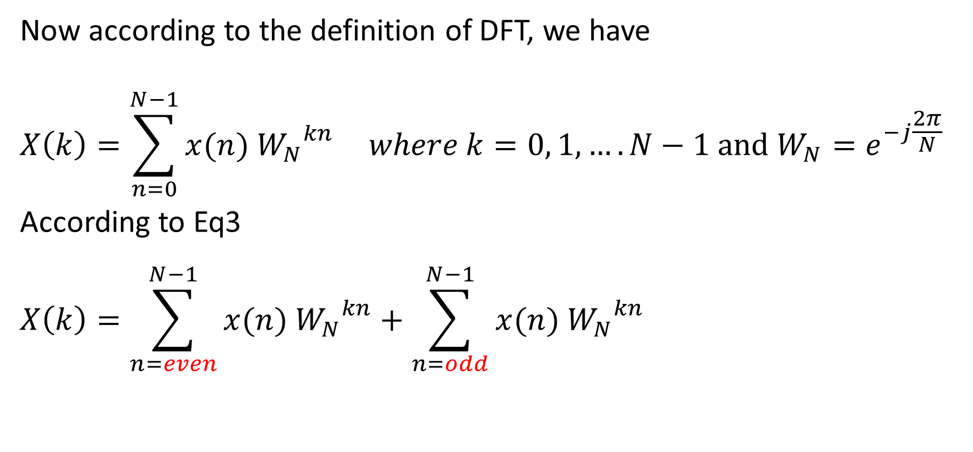
Radix-2 Decimation In Time (DIT) FFT Algorithm
Now according to the definition of DFT, we have
$$X\left(k\right)=\sum_{n=0}^{N−1}{x(n) {W_{N}}^{kn}} where k=0, 1, ….N−1 and W_{N}=e^{−j\frac{2π}{N}}$$
According to Eq3
$$X\left(k\right)=\sum_{n=even}^{N−1}{x(n) {W_{N}}^{kn}}+\sum_{n=odd}^{N−1}{x(n) {W_{N}}^{kn}}$$

Slide 8
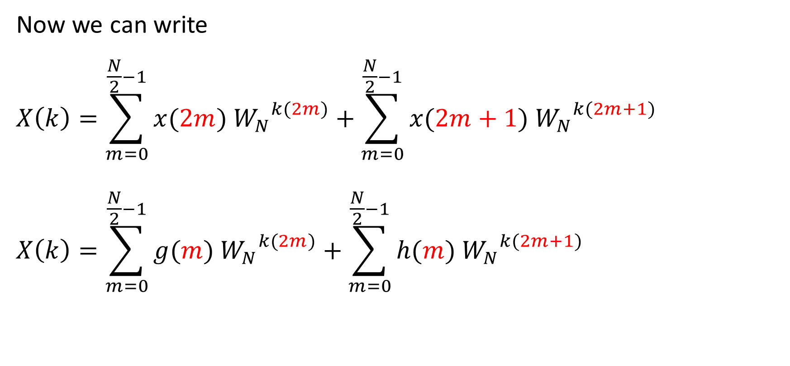
Radix-2 Decimation In Time (DIT) FFT Algorithm
Now we can write
$$X\left(k\right)=\sum_{m=0}^{\frac{N}{2}−1}{x(2m) {W_{N}}^{k(2m)}}+\sum_{m=0}^{\frac{N}{2}−1}{x(2m+1) {W_{N}}^{k(2m+1)}}$$
$$X\left(k\right)=\sum_{m=0}^{\frac{N}{2}−1}{g(m) {W_{N}}^{k(2m)}}+\sum_{m=0}^{\frac{N}{2}−1}{h(m) {W_{N}}^{k(2m+1)}}$$

Slide 9
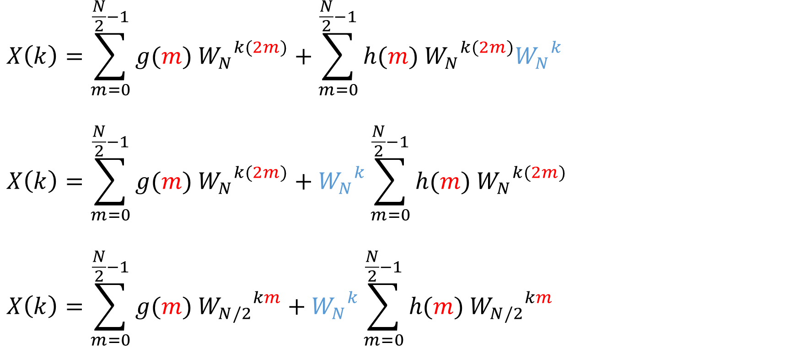
Radix-2 Decimation In Time (DIT) FFT Algorithm
$$X\left(k\right)=\sum_{m=0}^{\frac{N}{2}−1}{g(m) {W_{N}}^{k(2m)}}+\sum_{m=0}^{\frac{N}{2}−1}{h(m) {W_{N}}^{k(2m)}{W_{N}}^{k}}$$
$$X\left(k\right)=\sum_{m=0}^{\frac{N}{2}−1}{g(m) {W_{N}}^{k(2m)}}+{W_{N}}^{k}\sum_{m=0}^{\frac{N}{2}−1}{h(m) {W_{N}}^{k(2m)}}$$
$$X\left(k\right)=\sum_{m=0}^{\frac{N}{2}−1}{g(m) {W_{N/2}}^{km}}+{W_{N}}^{k}\sum_{m=0}^{\frac{N}{2}−1}{h(m) {W_{N/2}}^{km}}$$

Slide 10
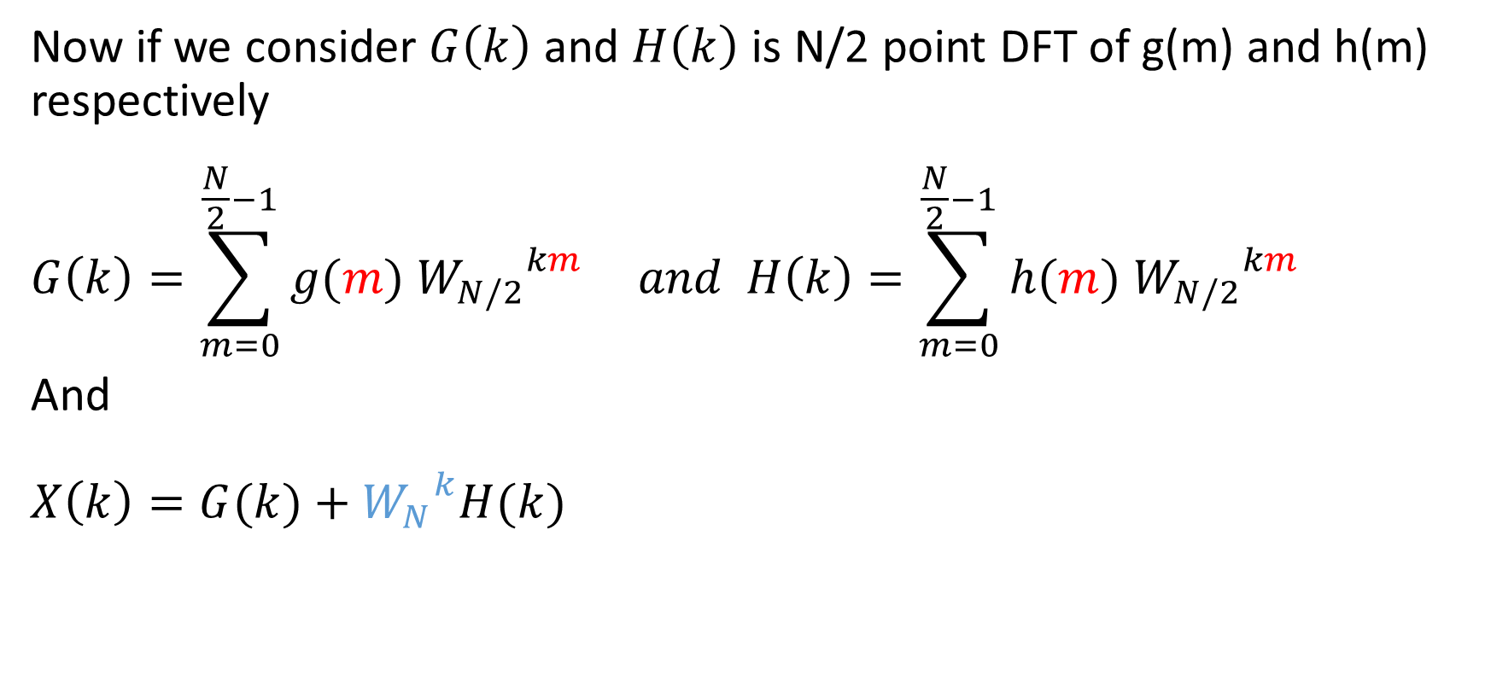
Radix-2 Decimation In Time (DIT) FFT Algorithm
Now if we consider $G\left(k\right)$ and $H\left(k\right)$ is N/2 point DFT of g(m) and h(m) respectively
$$G\left(k\right)=\sum_{m=0}^{\frac{N}{2}−1}{g(m) {W_{N/2}}^{km}} and H\left(k\right)=\sum_{m=0}^{\frac{N}{2}−1}{h(m) {W_{N/2}}^{km}}$$
And
$$X\left(k\right)=G(k)+{W_{N}}^{k}H(k)$$

Slide 11
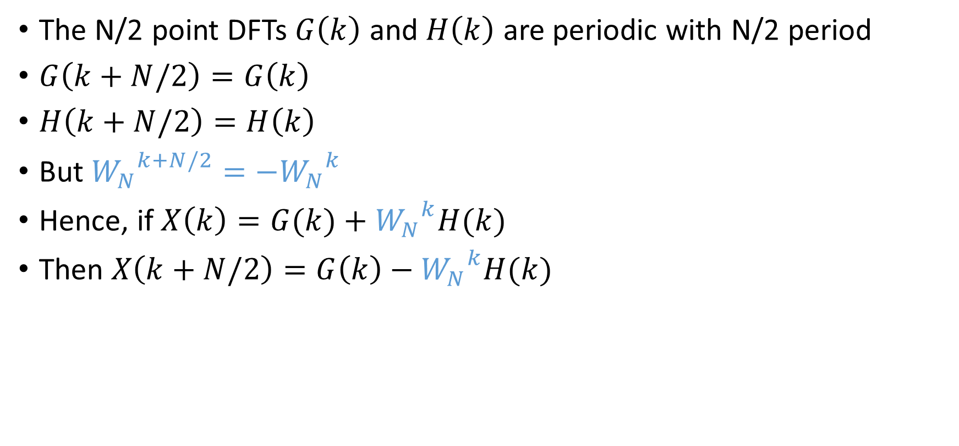
Radix-2 Decimation In Time (DIT) FFT Algorithm
The N/2 point DFTs $G\left(k\right)$ and $H\left(k\right)$ are periodic with N/2 period
$G\left(k+N/2\right)=G\left(k\right)$
$H\left(k+N/2\right)=H\left(k\right)$
But ${W_{N}}^{k+N/2}={{−W}_{N}}^{k}$
Hence, if $X\left(k\right)=G(k)+{W_{N}}^{k}H(k)$
Then $X\left(k+N/2\right)=G\left(k\right)−{W_{N}}^{k}H(k)$

Slide 12
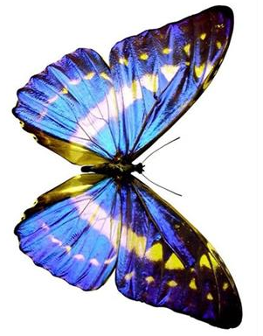

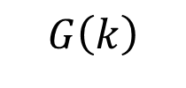


Radix-2 Decimation In Time (DIT) FFT Algorithm
Butterfly diagram
$$G\left(k\right)$$
X(k)
$$W_{N}^{k}$$
$$H\left(k\right)$$
$${−W}_{N}^{k}$$
X(k+N/2)

Slide 13








Radix-2 Decimation In Time (DIT) FFT Algorithm
1st Stage of Decimation 8-Point FFT
h(m)
X(k)
x(n)
H(k)
4 point DFT
H(0)
X(0)
x(0)
H(1)
X(1)
x(1)
H(2)
X(2)
x(2)
H(3)
$$W_{N}^{0}$$
X(3)
x(3)
$$W_{N}^{1}$$
x(4)
4 point DFT
G(0)
$${−W}_{N}^{4}$$
$$W_{N}^{2}$$
X(4)
$$W_{N}^{3}$$
X(5)
x(5)
G(1)
$${−W}_{N}^{5}$$
x(6)
G(2)
$${−W}_{N}^{6}$$
X(6)
x(7)
G(3)
$${−W}_{N}^{7}$$
X(7)
g(m)
G(k)

Slide 14
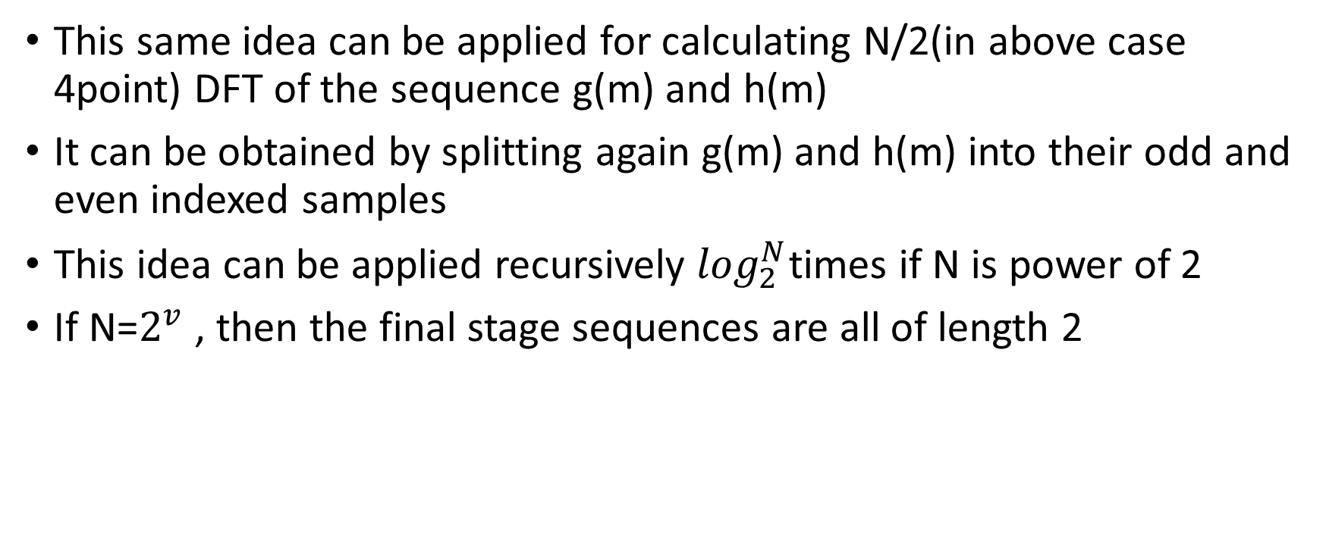
Radix-2 Decimation In Time (DIT) FFT Algorithm
This same idea can be applied for calculating N/2(in above case 4point) DFT of the sequence g(m) and h(m)
It can be obtained by splitting again g(m) and h(m) into their odd and even indexed samples
This idea can be applied recursively $\log_{2}^{N}$times if N is power of 2
If N=$2^{v}$ , then the final stage sequences are all of length 2

Slide 15
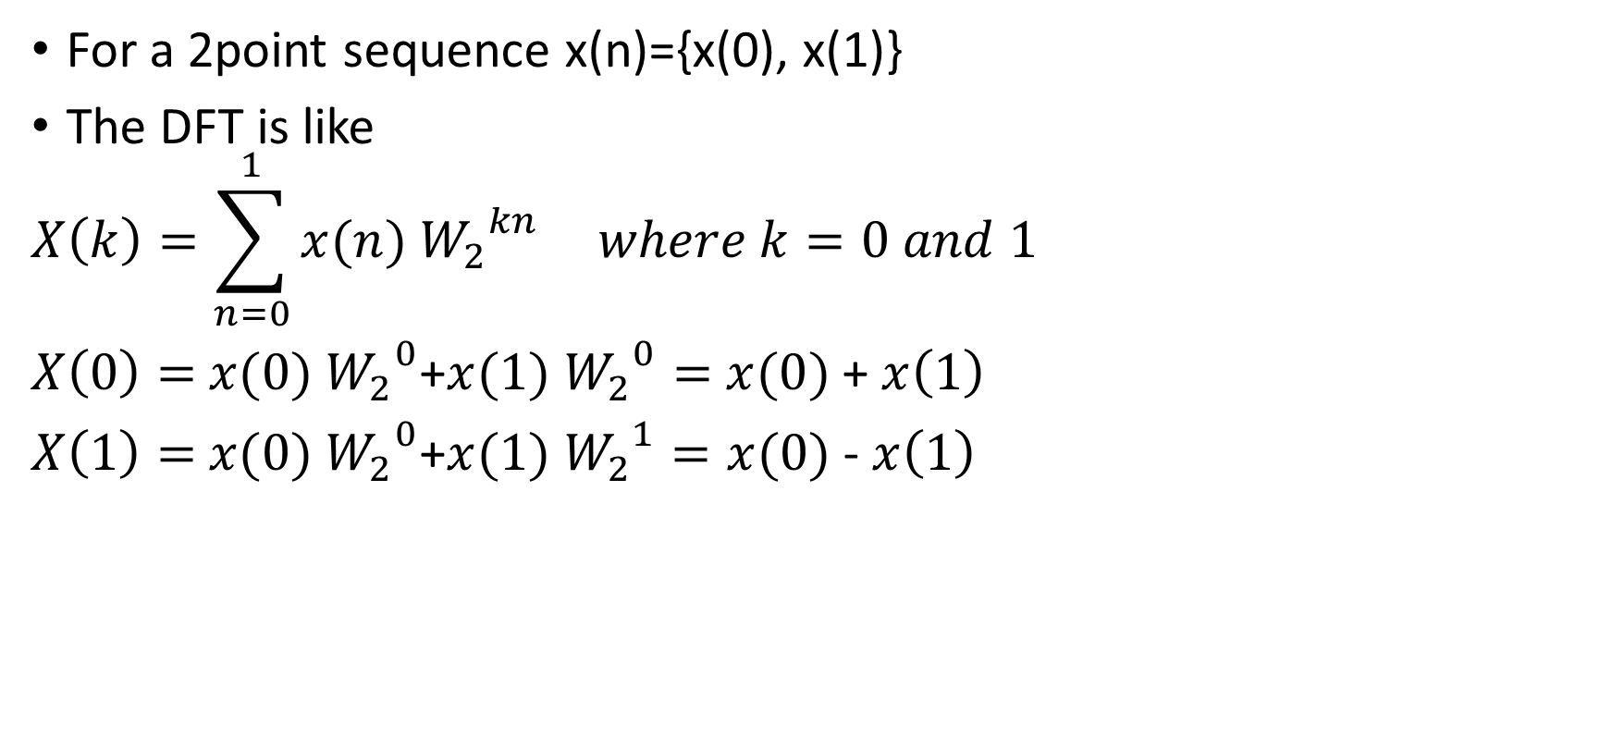
Radix-2 Decimation In Time (DIT) FFT Algorithm
For a 2point sequence x(n)={x(0), x(1)}
The DFT is like
$$X\left(k\right)=\sum_{n=0}^{1}{x(n) {W_{2}}^{kn}} where k=0 and 1$$
$X\left(0\right)=$ $x(0) {W_{2}}^{0}$+$x(1) {W_{2}}^{0}=$ $x(0)$+ $x\left(1\right)$
$X\left(1\right)=$ $x(0) {W_{2}}^{0}$+$x(1) {W_{2}}^{1}=x(0) \text{−} x\left(1\right)$

Slide 16
Radix-2 Decimation In Time (DIT) FFT Algorithm
2-Point FFT
x(0)
X(0) = x(0)+x(1)
x(n)
X(k)
x(1)
-1
X(1) = x(0)-x(1)

Slide 17
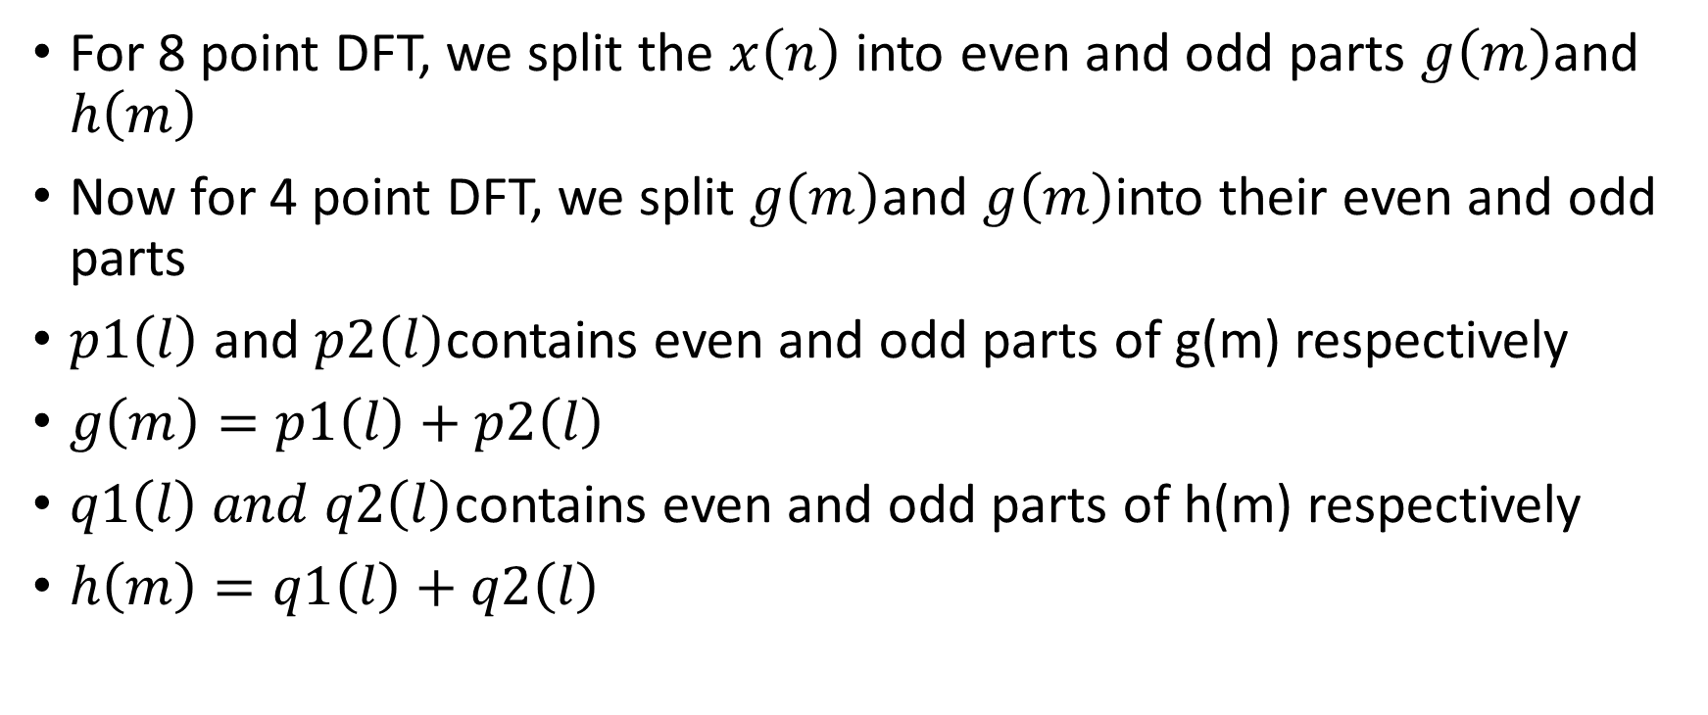
Radix-2 Decimation In Time (DIT) FFT Algorithm
For 8 point DFT, we split the $x\left(n\right)$ into even and odd parts $g\left(m\right)$and $h\left(m\right)$
Now for 4 point DFT, we split $g\left(m\right)$and $g\left(m\right)$into their even and odd parts
$p1\left(l\right)$ and $p2\left(l\right)$contains even and odd parts of g(m) respectively
$g\left(m\right)=p1\left(l\right)+p2\left(l\right)$
$q1\left(l\right) and q2\left(l\right)$contains even and odd parts of h(m) respectively
$h\left(m\right)=q1\left(l\right)+q2\left(l\right)$

Slide 18
Radix-2 Decimation In Time (DIT) FFT Algorithm
x(n)
g(m)
p1(l)
p2(l)
h(m)
q1(l)
q2(l)

Slide 19







































Radix-2 Decimation In Time (DIT) FFT Algorithm
$$x\left(n\right)$$
$$x\left(0\right)$$
$$x\left(1\right)$$
$$x\left(2\right)$$
$$x\left(3\right)$$
$$x\left(4\right)$$
$$x\left(5\right)$$
$$x\left(6\right)$$
$$x\left(7\right)$$
Even
Odd
$$g\left(m\right)$$
$$h\left(m\right)$$
$$x\left(0\right)$$
$$x\left(2\right)$$
$$x\left(4\right)$$
$$x\left(6\right)$$
$$x\left(1\right)$$
$$x\left(3\right)$$
$$x\left(5\right)$$
$$x\left(7\right)$$
Even
Odd
Even
Odd
p1$\left(l\right)$
p2$\left(l\right)$
q1$\left(l\right)$
q2$\left(l\right)$
$$g\left(0\right)$$
$$g\left(2\right)$$
$$g\left(1\right)$$
$$g\left(3\right)$$
$$h\left(0\right)$$
$$h\left(2\right)$$
$$h\left(1\right)$$
$$h\left(3\right)$$
$$x\left(2\right)$$
$$x\left(1\right)$$
$$x\left(5\right)$$
$$x\left(3\right)$$
$$x\left(7\right)$$
$$x\left(0\right)$$
$$x\left(4\right)$$
$$x\left(6\right)$$

Slide 20
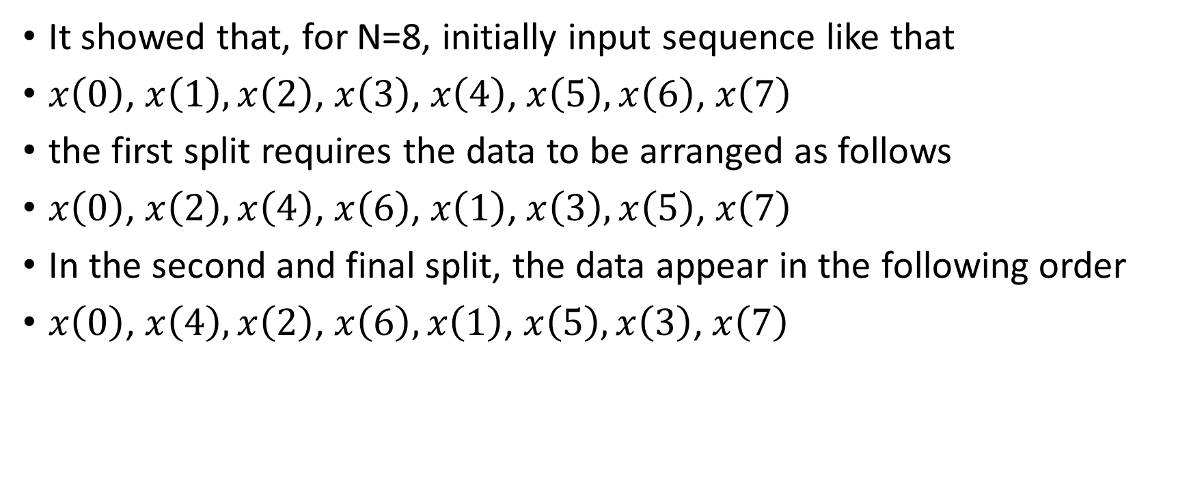
Radix-2 Decimation In Time (DIT) FFT Algorithm
It showed that, for N=8, initially input sequence like that
$x\left(0\right)$, $x\left(1\right),x\left(2\right)$, $x\left(3\right)$, $x\left(4\right)$, $x\left(5\right),x\left(6\right)$, $x\left(7\right)$
the first split requires the data to be arranged as follows
$x\left(0\right)$, $x\left(2\right),x\left(4\right)$, $x\left(6\right)$, $x\left(1\right)$, $x\left(3\right),x\left(5\right)$, $x\left(7\right)$
In the second and final split, the data appear in the following order
$x\left(0\right)$, $x\left(4\right), x\left(2\right)$, $x\left(6\right), x\left(1\right)$, $x\left(5\right), x\left(3\right)$, $x\left(7\right)$

Slide 21
Radix-2 Decimation In Time (DIT) FFT Algorithm
Here index can be calculated by using a very easy method, called ‘Bit reversal method’. Like as following
Original Index
0
1
2
3
4
5
6
7
Binary Form
000
001
010
011
100
101
110
111
Reversed Form
000
100
010
110
001
101
011
111
Final Index
0
4
2
6
1
5
3
7
X
Y
Z
Z
Y
X

Slide 22








Radix-2 Decimation In Time (DIT) FFT Algorithm
Final presentation of 8-Point FFT
X(k)
x(n)
X(0)
x(0)
x(1)
$$W_{N}^{0}$$
X(1)
-1
x(2)
$$W_{N}^{0}$$
X(2)
-1
x(3)
$$W_{N}^{2}$$
-1
X(3)
$$W_{N}^{0}$$
-1
$$W_{N}^{0}$$
-1
X(4)
x(4)
x(5)
$$W_{N}^{0}$$
$$W_{N}^{1}$$
-1
X(5)
-1
$$W_{N}^{0}$$
$$W_{N}^{2}$$
-1
X(6)
x(6)
-1
$$W_{N}^{2}$$
$$W_{N}^{3}$$
-1
X(7)
x(7)
$$W_{N}^{0}$$
-1
-1

Slide 23
Thank you

